Slide 1
Введение в Mendeley
25.03.2016
Notes:
Welcome to this introductory session on Mendeley. This presentation will cover the basics of what Mendeley is, how it can help to improve your research and writing processes and how you actually use it.
Mendeley is designed to help you to achieve three main goals:
Organizing your references, by allowing you to create a personal library of materials and structuring it as you see fit. It can help you keep track of different papers you’re reading - by adding notes and highlights, and by remembering where you had reached.
Collaborating with others. Mendeley allows you to come together with other users to share references and to exchange ideas. You can also use private groups to share full-text papers and to collaboratively annotate. You can use this functionality to work with people you see every day, or use Mendeley’s social features to find people with similar interests from around the world.
Discover. In addition to helping you discover new people to work with, Mendeley can also help you to find new research being published in your field - and to recommend new reading based on the contents of your personal library.

Slide 2
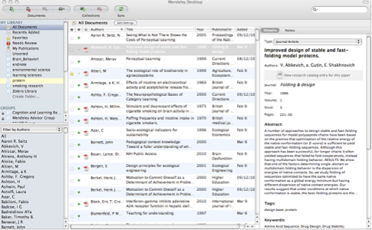
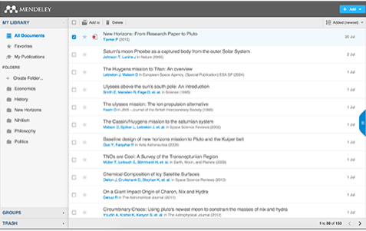
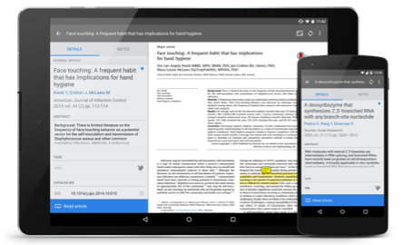
Что такое Mendeley?
Приложение для научной работы
Поддержка всех основных платформ (Win/Mac/Linux/Mobile)
и всех брайзеров
Desktop
Web
Mobile
Notes:
So what is Mendeley? Mendeley is free software which is available across a number of different platforms. You can run Mendeley on your computer or laptop, your phone or tablet, and also access it from any modern browser. You can either download the appropriate app for your particular device, or use your web browser to log onto the web version.
Mendeley’s Desktop application offers the most complete experience - allowing you to organize, collaborate and discover, as well as use the citation plugin to cite as you write in Microsoft Word or LibreOffice. We’ll cover this in more detail later on.
The other versions - Web and Mobile - offer you the ability to access your references on the go, as well as making notes and annotations.

Slide 3
Зачем нужен Mendeley?
Notes:
Mendeley acts as a repository for your reference information. You add papers to your library by importing PDF files stored on your computer, or by retrieving them from other locations - like online catalogs such as ScienceDirect, Scopus, Pubmed or PLOS. You can also create entries for items that you don’t have access to as PDFs by manually entering details.
Materials you add to your library are then stored in the cloud, for you to retrieve wherever you need them. It might be that you want to read a paper on the way home on the train, or you need to write a paper on your main computer. Mendeley allows you to retrieve the same resources with the same enhancements and annotations wherever you need them.

Slide 4
Обзор основных возможностей
Что дает Mendeley
Notes:
Let’s talk briefly about how the product works, what it looks like and how you might like to use it.

Slide 5
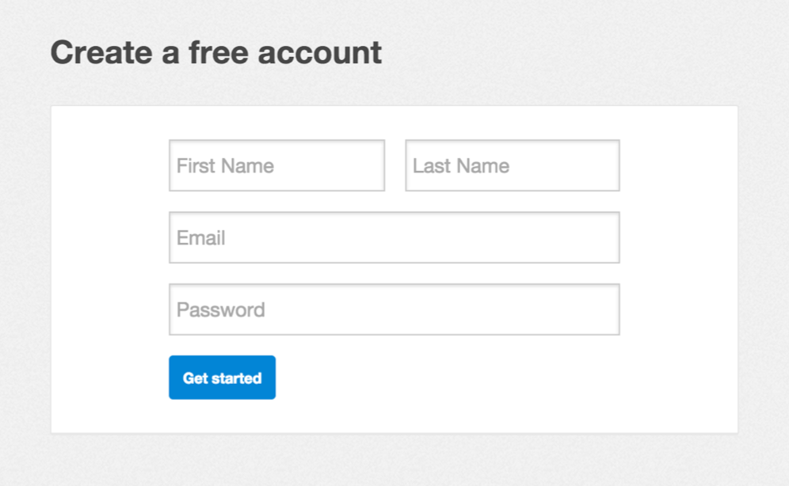
С чего начать?
www.mendeley.com
Notes:
The first thing you’ll need to do is to create an account via mendeley.com. This is completely free to do and only takes a few seconds. You’ll need a Mendeley account to log into the different versions of the software.
Once you’ve created your account you’ll be prompted to download the appropriate version of Mendeley Desktop for your current machine. You don’t have to do this right away, but it’s a good idea to have the desktop application installed on your main working computer.

Slide 6
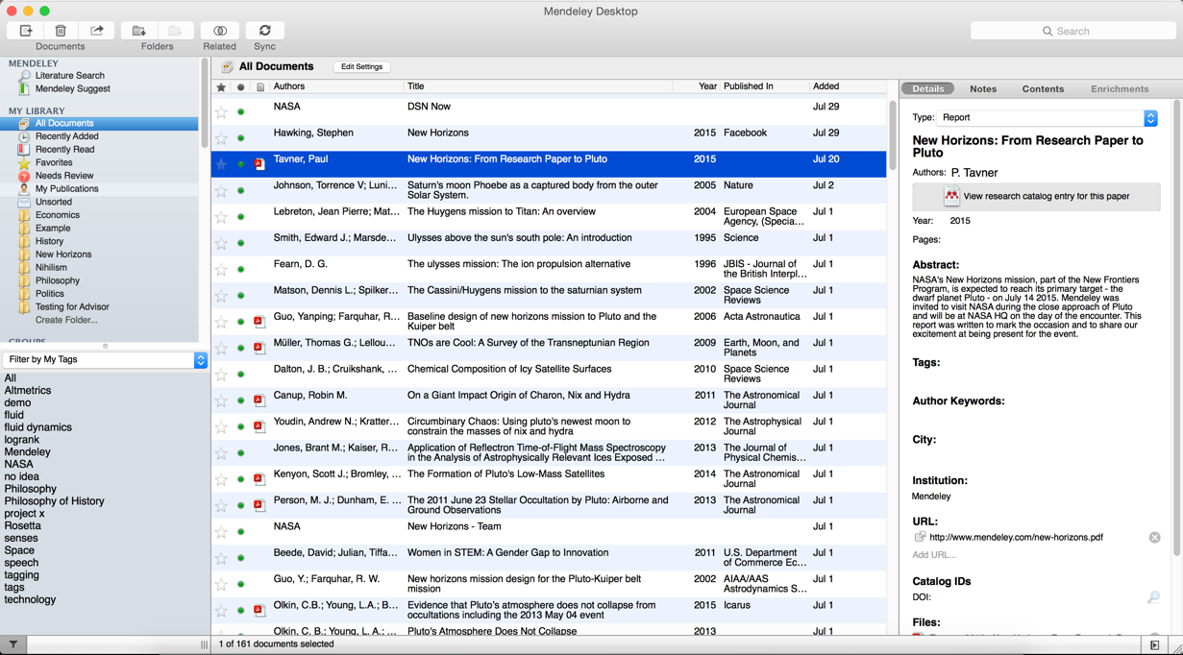
Mendeley Desktop
Notes:
This is how Mendeley Desktop looks on a Mac. The Windows version may have a few cosmetic differences, but the functionality is exactly the same. This presentation uses Mac screenshots throughout - but don’t let that put you off if you use a Windows PC.
Mendeley Desktop offers the complete Mendeley experience. It allows you to build, maintain and order your personal library. It also allows you to access reading and writing functions. We’ll go through these in more detail later.
When you first open Mendeley Desktop, you’ll need to log into your Mendeley account. This ensures that any changes you make are being made to your own account and will be carried across when you log into different devices.
Mendeley Desktop follows a three column structure. The left-hand panel allows you to navigate through different filtering options for your library. When you click on different folders or groups listed in this column, different lists of papers will be returned in the main panel. In this screenshot we have ‘All Documents’ selected, which means the main panel is listing all of our references.
The middle panel allows you to select individual references. Clicking on a reference listed here will display this document’s details in the right-hand panel. You can also select multiple papers to undertake bulk actions, such as mass deletions or additions to folders.
The right panel shows the details of your selected reference. You can also use this panel to modify the details by clicking into the individual fields. You should carefully check and correct the details displayed in this panel as ensuring accuracy here will ensure that your citations are totally correct.
We’ll go into the details of how the interface works in just a few minutes.

Slide 7
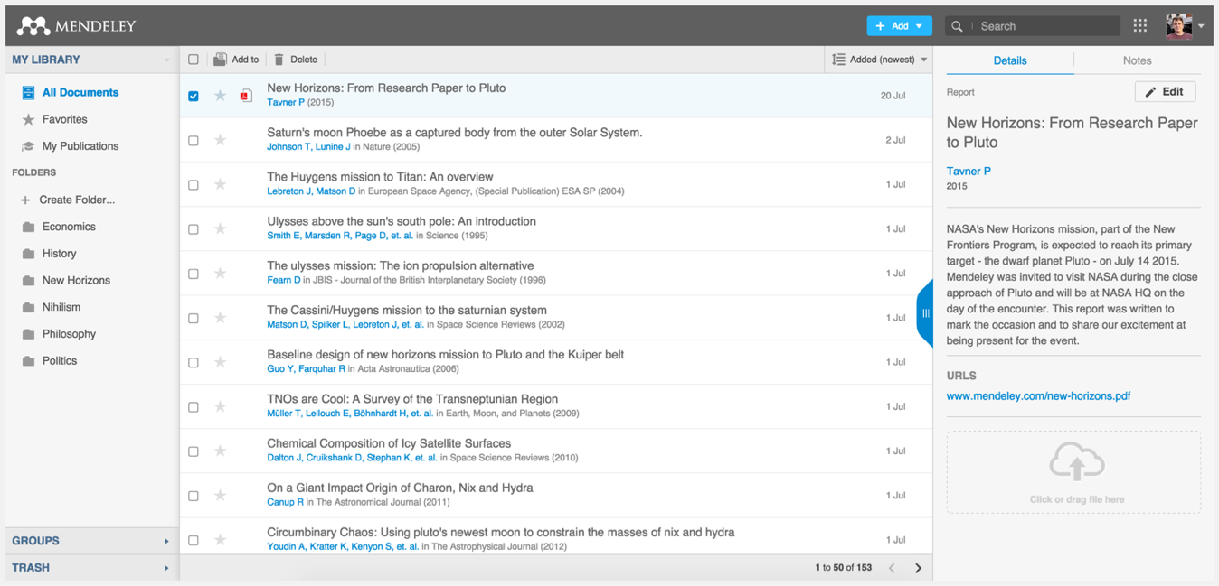
Mendeley Web
Notes:
Mendeley Web is the version of Mendeley accessible via your web browser. You’ll need to be logged into your Mendeley account in order to access it.
The layout is similar to what we’ve just seen for Mendeley Desktop - although it has been optimized for use in a browser. The same three-column structure persists. We won’t go into too much detail on Mendeley Web here - but if you’re interested in using it, there’s a dedicated guide available in the Mendeley Resource Center.

Slide 8
Организация хранения
Наполните библиотеку
Notes:
So let’s talk about how Mendeley can help you to bring organization to your references.

Slide 9
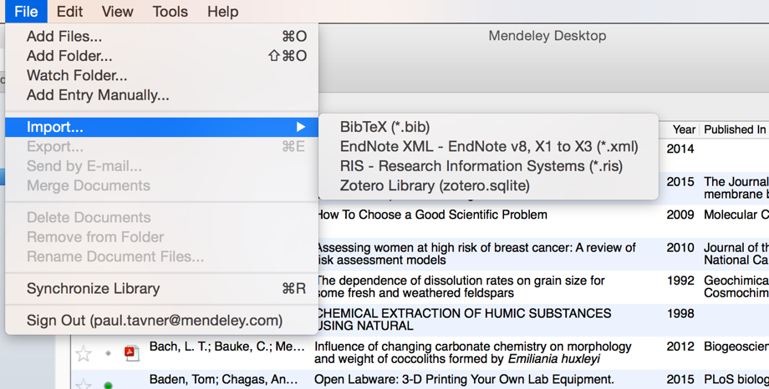
Как добавить публикации?
Выберите файл или папку на своем компьютере
Импортируйте из другого
менеджера ссылок или BibTeX
Слежение за папкой
Ручное добавление
публикаций
Notes:
Mendeley also offers a number of other options for adding material to your library. You can find these by opening the File menu.
You can choose to add individual files, or the contents of an entire folder by browsing to the relevant location on your computer.
You can opt to ‘watch’ a folder - which will mean that Mendeley monitors that location for any new items being dropped into the folder. If it finds a new document, that document will be automatically added to your Mendeley library.
You can also easily import a library from other reference managers, so if you’ve tried out EndNote, Reworks or another solution and found them not to your liking, you can carry across your library to Mendeley easily.
You also have the option to create a reference manually - which will allow you to complete a number of fields by hand.

Slide 10
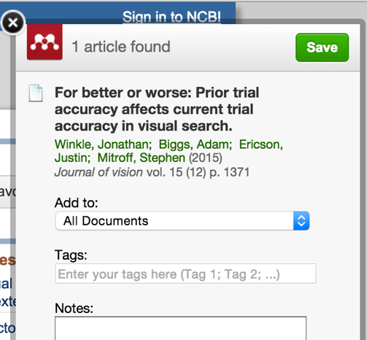
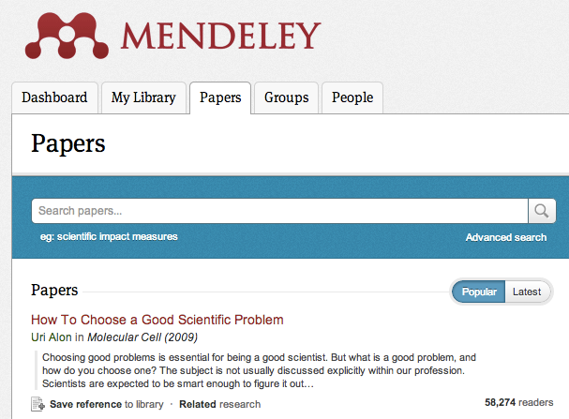
Поиск новых публикаций
Mendeley Web Importer
Mendeley Research Catalog
Notes:
Mendeley makes it easy for you to continue building your library.
The Web Importer is a bookmarklet that you can add to your web browser. When you click on this item in your browser’s favorites, the Web Importer will attempt to detect references on the page you’re viewing and ask if you want to add them to your library. You can also use it to add web pages to your library. I’ll show you the Web Importer in more detail shortly.
Mendeley also operates a Research Catalog - the largest crowd-sourced collections of Papers available online. You can search the online catalog to identify references you want in your library, and add them with just a few clicks.
Certain online catalogs, such as ScienceDirect - pictured here - allow you to export references directly to Mendeley. Look out for the Export button on pages like this.
Other catalogs will allow you to export in file formats such as RIS, which can then be added to Mendeley using the File menu.

Slide 11
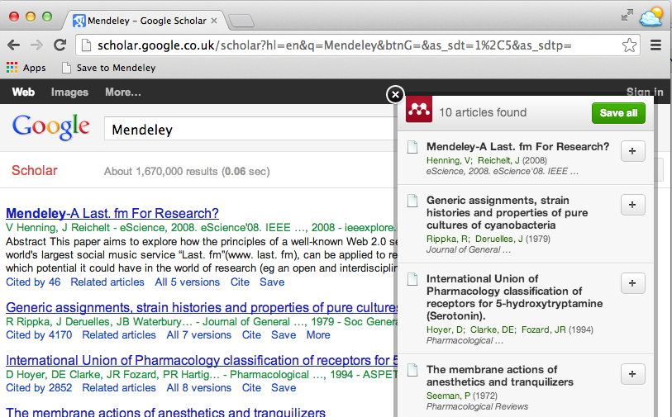
Пример использования Web Importer
Нажмите на ссылку ‘Save to Mendeley’ для сохрания библиографии с любого ресурса в интернете
Выберите нужную статью и в один клик сохраните ее в библиотеку Mendeley
Notes:
Any time you come across an interesting article online, or when you do a search on Google Scholar or one of our many partner sites, you can save this article to your library by clicking ‘Save to Mendeley’. A window will then pop up, like the one you see on the right. Select any articles you’d like to import, and then click the green button to save them. Done! Mendeley will also save the PDF, it available.

Slide 12
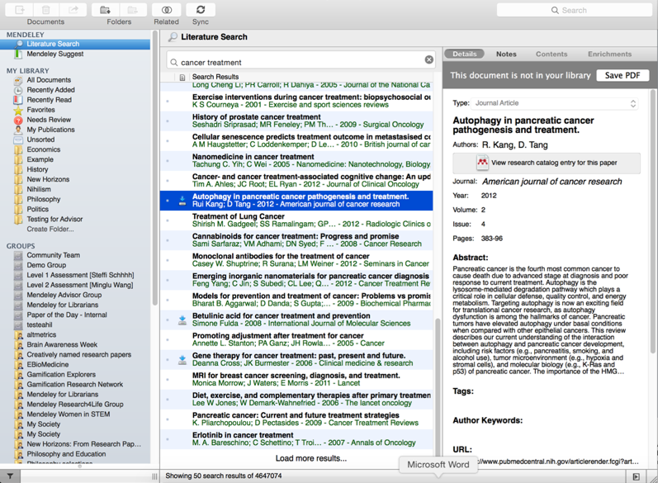
Поиск источников в каталоге Mendeley
Используете каталог Mendeley
Сохраните документ в библиотеку в один клик
Система подскажет, есть ли полный текст статьи
Notes:
If you know the name of a paper or if you have a specific topic in mind, you can use the Literature Search setting from within Mendeley Desktop. This allows you to retrieve new references from the Mendeley Web Catalog.
As the Catalog is crowd-sourced, the Literature Search can only retrieve papers that have already been added by other users - so if your desired result is a very new or obscure paper, you may not be able to retrieve it.
If the full text of a paper is available - for example, if the paper is open access - you’ll see an icon allowing you to download it.

Slide 13
Синхронизация
Notes:
Syncing is a core concept in Mendeley. Whenever you make changes in Mendeley, you’ll need to sync in order to push those changes up into cloud storage. Syncing will also pull down any changes made on other devices. It’s a good idea to sync regularly to ensure that your documents and annotations are saved in the cloud.
You can sync at any time by using the sync button. Mendeley will also sync automatically each time you open it.

Slide 14
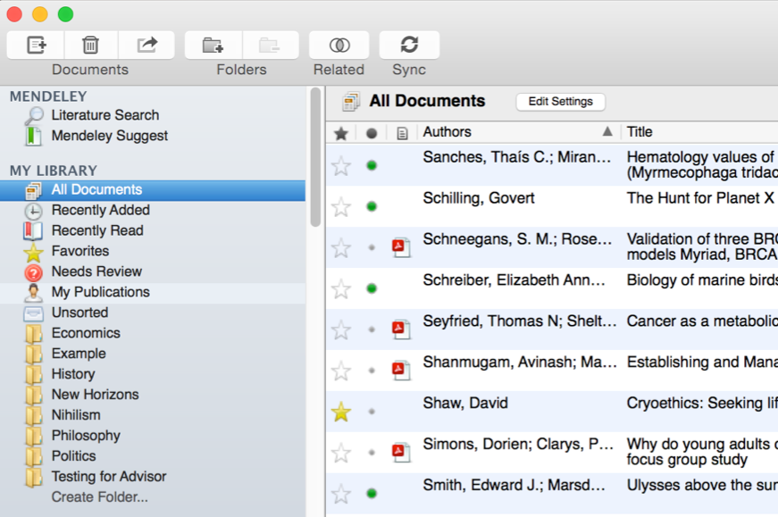
Управление библиотекой
Сортировка по любому столбцу
Пометка прочитанное/ непрочитанное
Записи с PDF можно открыть прямо в Mendeley
Пометка Избранное
Notes:
Mendeley Desktop’s interface should be fairly intuitive if you’re familiar with programs like iTunes, or even Gmail. The left-hand panel offers a number of different options to help filter your document list to exactly what you need to find.
The default position when opening Mendeley Desktop is ‘All Documents,’ which will list all items in your library. You can use the column headings (such as Author Names, Year, etc.) to order your documents by that value - this can be useful for finding works by a specific author, for example.
When you add materials to your library, they will initially be marked as unread - indicated by a large green dot in the second column. You can toggle this off and on by clicking it. Alternatively, a document will be marked as read once you’ve spent a certain amount of time reading it in the Mendeley PDF reader.
You can ‘star’ documents to mark them as favorites. They can then be easily retrieved via the left-hand panel.
You can also use the left-hand panel to access items you’ve recently added, or items you’ve recently read.

Slide 15
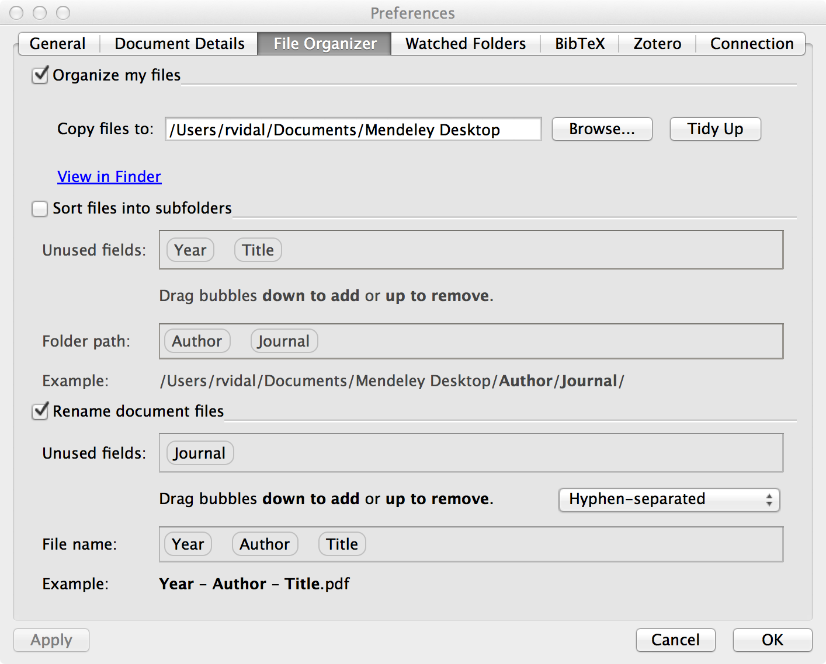
Организатор хранения файлов
Notes:
As you can see, we’ve paid a lot of attention to features that allow you to easily search and filter your references within Mendeley desktop. There’s an additional option that can be found in the Preferences menu that allows you to keep the actual PDFs sorted on your computer nicely organized. By selecting the desired location and file name and folder structure, Mendeley uses the reference metadata to rename and rewrite the folder and files to your selections.

Slide 16
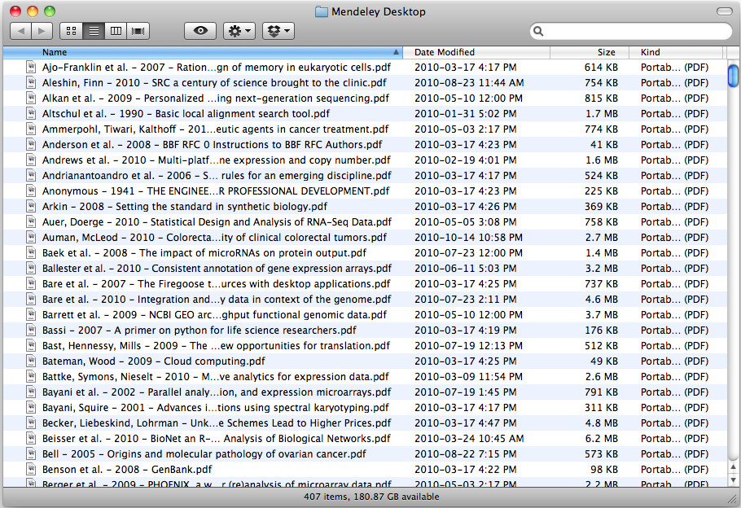
Организатор хранения файлов
Notes:
And here is what it looks like once we activate the

Slide 17
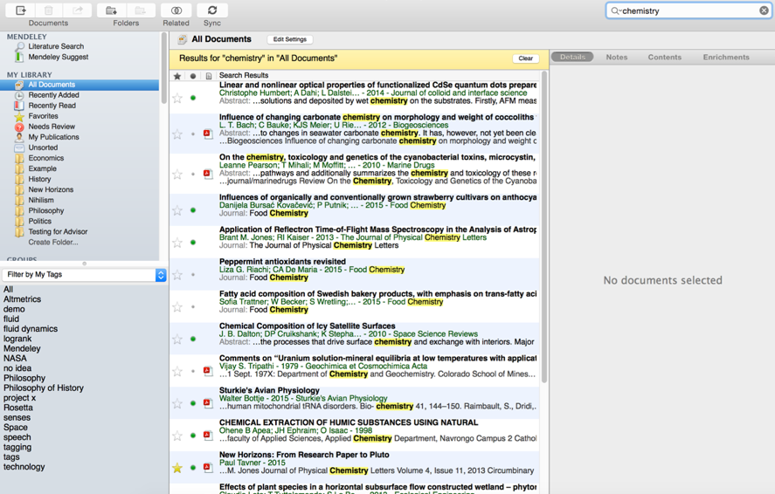
Поиск по вашей библиотеке
Мгновенный поиск во всех атрибутах документа и полном тексте
Notes:
Mendeley offers a powerful search tool to help you to locate items in your library. Just enter your search term in the field which appears in the top right corner and Mendeley will filter your current view to show references which contain that term. It will also search within the full text of PDF papers which appear in your library.
The search is context specific, so if you’re not getting the results you expect make sure that you have the appropriate folder selected in the left-hand panel. If in doubt, select ‘All Documents’.
Use the ‘clear’ button which appears on the yellow toolbar to remove the search filter.

Slide 18
PDF Viewer
Просмотр и аннотирование документов
Notes:
If you’ve added PDF papers to your library, you’ll also be able to open them for reading within Mendeley Desktop. This offers you a number of opportunities…

Slide 19
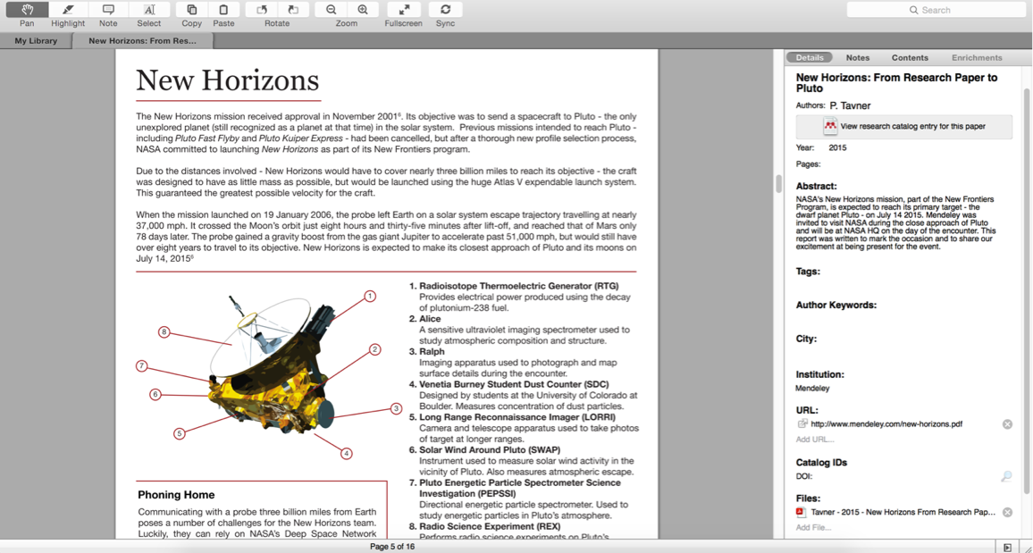
Чтение PDF в Mendeley
Notes:
The Reader’s layout will be familiar if you’ve used Adobe Acrobat or similar software. At the top of the screen you’ll see a number of tools, which are mostly self-explanatory.
You’ll also notice that Mendeley operates a tabbed format - allowing you to open multiple PDFs for reading at once, and to switch back and forth between them.
Mendeley will remember where you were up to in a paper when you open it and take you back to the same place.

Slide 20
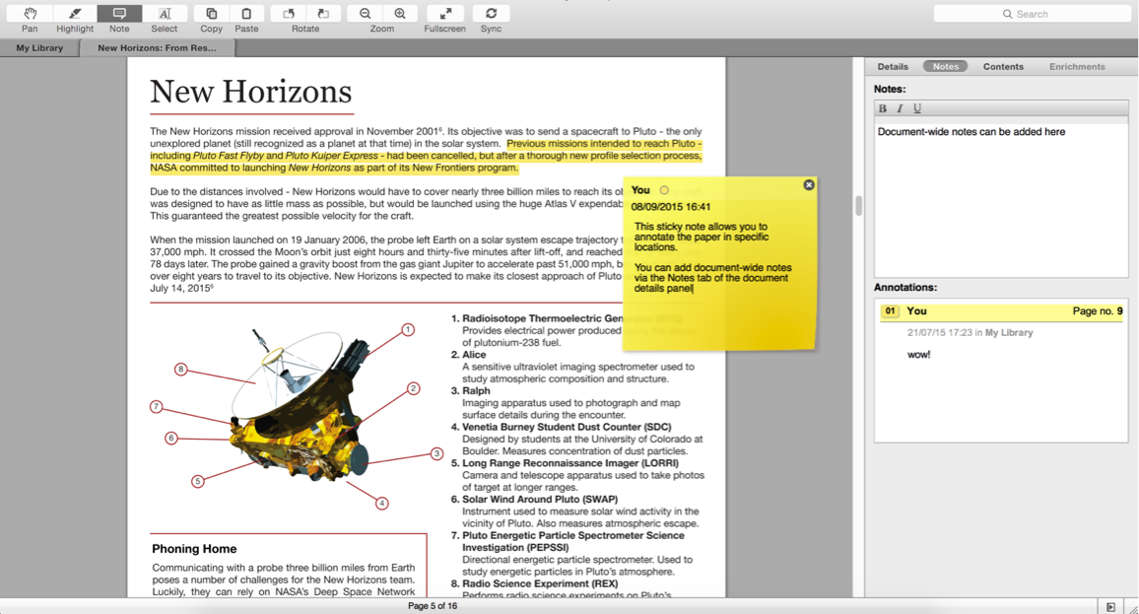
Выделение и аннотирование текста
Notes:
You can highlight important passages using the Highlight tool - just as you would when reading a physical copy. This allows you to pick out important passages from a paper.
You can also add notes to the paper to help organize your thoughts. These can be done either in the Notes box which appears in the document detail panels. These notes are document-wide and can also be viewed from the main library view - without opening the paper for reading.
Alternatively, you can add ‘sticky notes’ to specific locations in the text. These allow you to make content-specific notes at a particular location. Sticky notes that are added in this way will appear in the list of annotations in the document details panel. You can use these entries to jump to the appropriate location within the paper - allowing you to retrieve your notes in context.

Slide 21
Создавайте ссылки
Используя Mendeley Citation Plug-In
Notes:
One of the most popular features of Mendeley is its ability to improve the citing process. Mendeley makes it a lot easier to insert properly formatted citations throughout a paper you’re writing - and will automatically generate a bibliography for you. It also allows you to restyle your manuscript’s citations with just a few clicks - making it ideal for resubmissions to different journals or publishers.

Slide 22
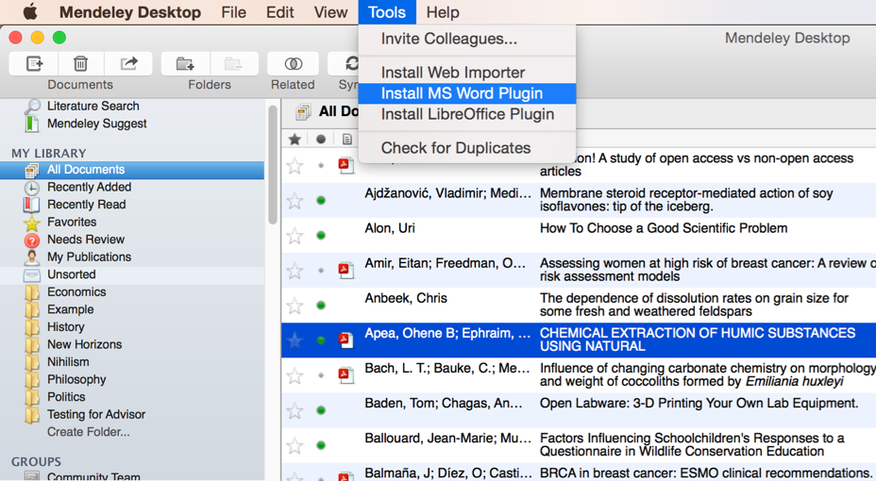
Установите Citation Plug-in
Notes:
You’ll first need to install the citation plugin. This can be done via the Tools menu within Mendeley Desktop.
The citation plugin supports Microsoft Word and the free alternative LibreOffice. Depending on which of these you have installed, you will see the prompt to install the plugin.
Once installed, the citation plugin will appear within your word processor. Its appearance will vary slightly depending on your operating system, but you will see the same buttons and options in both.

Slide 23
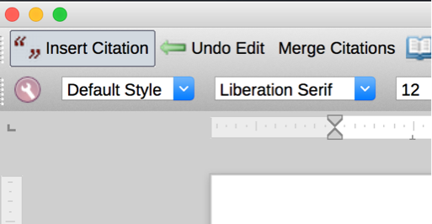
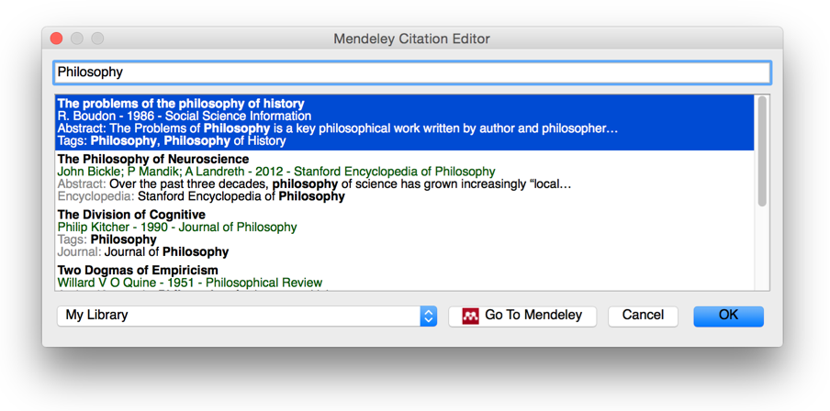
Добавляйте ссылки прямо из текстового редактора
Notes:
Inserting a citation is achieved by first positioning your cursor in the appropriate location and pressing the ‘Insert Citation’ button which appears on the Mendeley toolbar. You also need to be running Mendeley Desktop, and will be prompted to start it if it is not currently running.
Pressing the button will open the Mendeley search tool. This box allows you to enter a term - such as an author name - before returning search results from your library. Locate the reference you want to cite, click to select it and press the Ok button. You will see that the citation is added. Its appearance will vary depending on which citation style you currently have active - we’ll talk more about this shortly.
That’s all there is to it - you’ve added your first citation! Congratulations!
If you’re looking for a particular citation and can’t remember its details you can also opt to switch to Mendeley desktop to locate it - using search or filtering by tags, for example. Just press the ‘Go to Mendeley’ button to switch over to that interface.
Once you’ve located the appropriate reference, click to highlight it and press the ‘Cite’ button which temporarily appears on the Mendeley Desktop toolbar. If you want to cancel the citing process and return to your manuscript press the cancel button.
Note that your manuscript is considered locked while this process is active. You need to cancel the citation to return to the document, or insert a citation before you can switch back to your word processor.

Slide 24
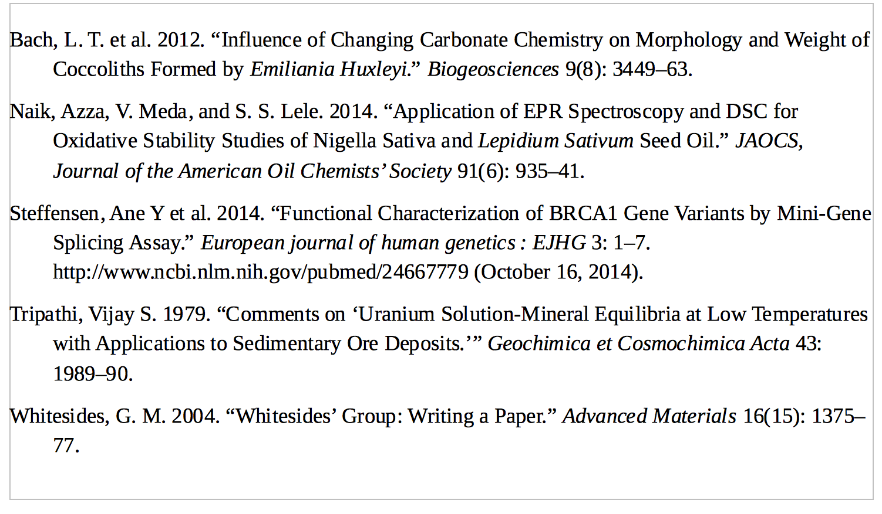
После написания статьи добавьте «Список литературы»
Notes:
Once you’ve done adding citations you’ll need to generate a bibliography. Ensure your cursor is positioned where you want your bibliography to appear and press the ‘Insert Bibliography’ button - it just takes one click!
Mendeley will now look through your manuscript, pick out all the citations you’ve added and order them into a list. The exact ordering and appearance of your bibliography will depend on the citation style - which we’ll talk about next.

Slide 25
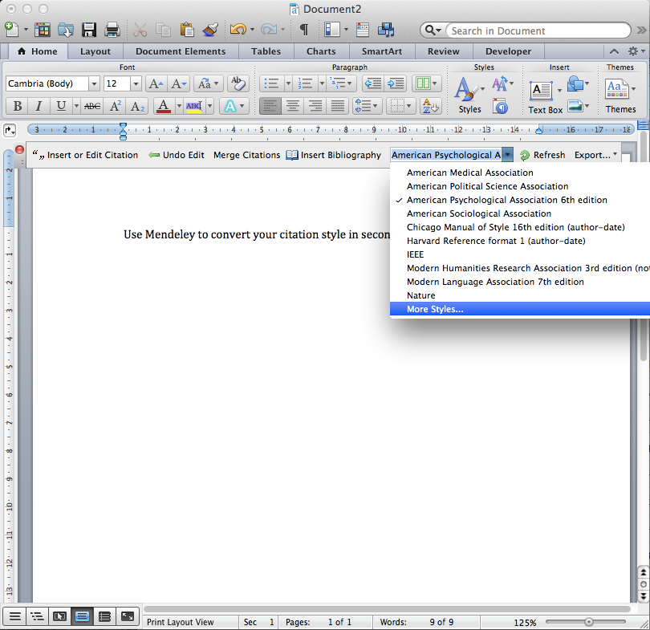
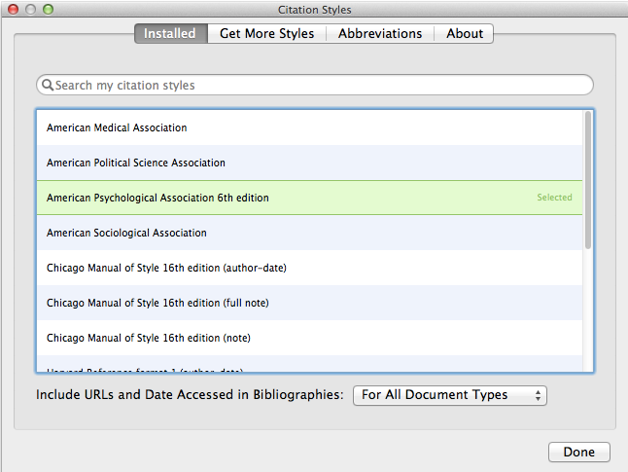
Выбор стиля цитирования
Notes:
Citation Styles are sets of styling instructions which control how your citations and bibliography appear. Different publishers and institutions require different formatting for citations when you wish to submit a paper.
Using Mendeley, you can choose the appropriate citation style for your manuscript - and also switch between different styles with just a few clicks. Mendeley will restyle all the citations in your manuscript automatically. To change citation styles, open the styles dropdown menu which appears on the Mendeley toolbar. If you don’t see the style you need, you can click ‘More Styles’ to be taken to the Styles tool within Mendeley Desktop. This will also allow you to download and install new styles in seconds.
Mendeley allows you to use over 1,600 different citation styles - but comes pre-installed with some of the most commonly used, such as APA, Harvard and IEEE.
If you still can’t find the right style or you’d like to customize an existing style, you may want to try the Mendeley CSL Editor, which allows you to customize citation styles. Saved styles are added to the Mendeley database, and will appear in your drop-down menu in Word.
You can also share created styles with other Mendeley users. The editor can be found at http://csl.mendeley.com

Slide 26
Сотрудничайте
Ведите коллективную научную работу
Notes:
Let’s talk a bit more about sharing now. Quite often you may want to share materials with other Mendeley users - or even to collaborate directly on a particular paper.

Slide 27
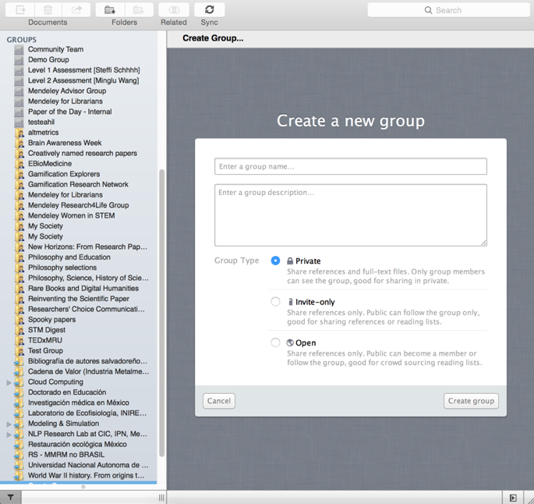
Работайте в группах
Документы добавляются в группу методом Drag&drop
Notes:
Groups are Mendeley’s solution to the the problem of collaboration. They allow you to come together with other users and to share resources. If you’ve already created or joined groups, you’ll see them listed in the left panel of Mendeley Desktop - underneath your personal folders. To add materials to a group, just drag and drop them onto the group name.
You can create new groups at any time by using the ‘Create Group…’ option. The process is quick and easy. Mendeley offers three different types of group:
Open - these groups are publicly visible and accessible to anyone. They will be listed in the groups directory on Mendeley’s website. Members can add references to the group - but only the reference details will be added.
Invite-only - these groups are publicly visible, but membership is controlled by the group admins. Anyone can ‘follow’ the group to access the references, but only full members can add or edit references.
Private - these groups are not publicly visible. Members need to be invited. Members can share full-text papers with each other, and can also collaboratively highlight & annotate on these materials.

Slide 28
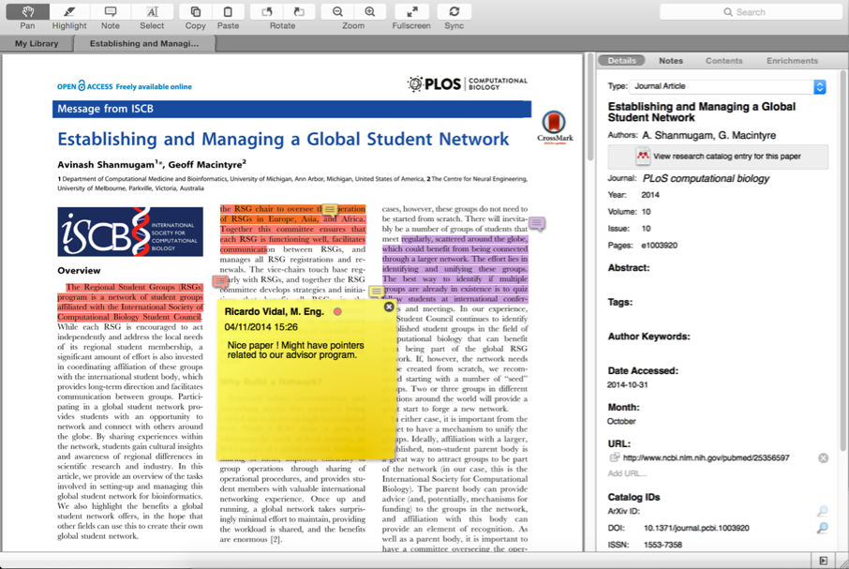
Создайте закрытую группу
Делитесь с коллегами по группе полнотекстовыми документами с аннотациями и выделениями
Notes:
Private groups, like all groups, offer the ability to communicate with other members via messages posted to the newsfeed. You’ll also receive notifications when new resources are added.
Each post on the group’s newsfeed creates a discussion thread - allowing you to comment on other members’ posts.
You can open papers shared with the private group using the Mendeley PDF Reader. Any highlights and annotations you add to the group version will be visible to other members of the group. Each contributor will be assigned a color to help distinguish their changes.
Add notes or highlight particular passages to draw your collaborators’ attention to particular sections of the paper.

Slide 29
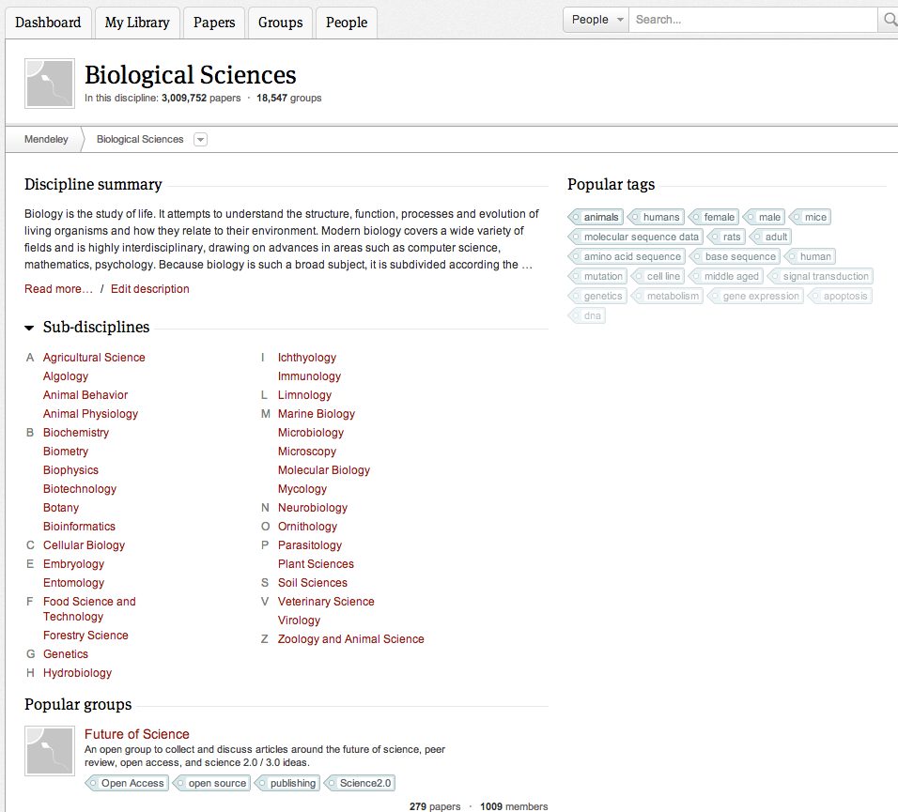
Присоединяйтесь к открытым научным группам
Используйте рубрикатор по отраслям наук
Notes:
You can also browse popular public groups by subject to locate popular groups associated with each topic.
Joining public groups is also a good way to connect with other Mendeley users who are active in your field. This can lead to collaboration and sharing of resources.

Slide 30
Создайте свой научный профиль
Получайте статистику о востребованности
своих работ
Общайтесь с коллегами и вступайте в научные группы
Расскажите о себе
Поделитесь результатами своих работ
Notes:
Completing your Mendeley profile is a great way to promote yourself and to encourage other users to get in touch. You can use your profile to share your interests and publications with the world.
When viewing another user’s profile you will have the option to ‘follow’ them, which will keep you up to date with their activity. You can also send them a direct message.

Slide 31
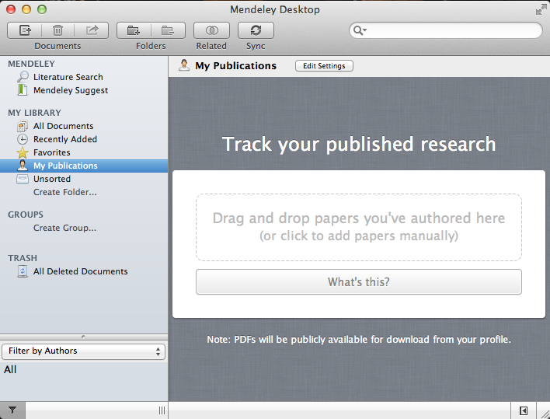
Представьте миру свои работы
Добавьте ваши публикации в вашу библиотеку Mendeley
Перенесите их в папку My Publications и они отобразятся на профиле
Notes:
You can use Mendeley to share your work with other users by adding your publications to your personal profile. Adding publications will make them available to other users via your profile, as well as connecting you to them in the Mendeley Web Catalog. If other users view your paper in the Catalog, they will see that you are a Mendeley user and will be able to connect with you.
To add your personal publications, open ‘My publications’ in Mendeley Desktop, and either drag & drop a file onto the specified area, or click to browse to a file on your computer.

Slide 32
Mendeley Institutional Edition

Slide 33
Mendeley Institutional Edition
 | Free Mendeley | Mendeley Institutional Edition
Доступное для хранения место | 2 GB | 5 GB
Место для хранения данных групп | 100 MB | 20 GB
Количество участников закрытых групп | 3 | До 25
Количество закрытых групп | 1 | Без ограничения
Страница Университета | Нет | Да

Slide 34
Спасибо за внимание!
Андрей Локтев,
консультант по ключевым информационным решениям Elsevier
e-mail: a.loktev@elsevier.com
www.facebook.com/ElsevierRussia
www.elsevierscience.ru
www.mendeley.com
Notes:
Hopefully we’ve covered enough of the basics of Mendeley in order for you to get up and running.
Thanks for your time today and we hope enjoy using Mendeley!

